Slide 1
L6 Group-1 Pitch 2
Caitlin White, Connor Wilby, Jamie Chandler and Jordan Marks

Slide 2
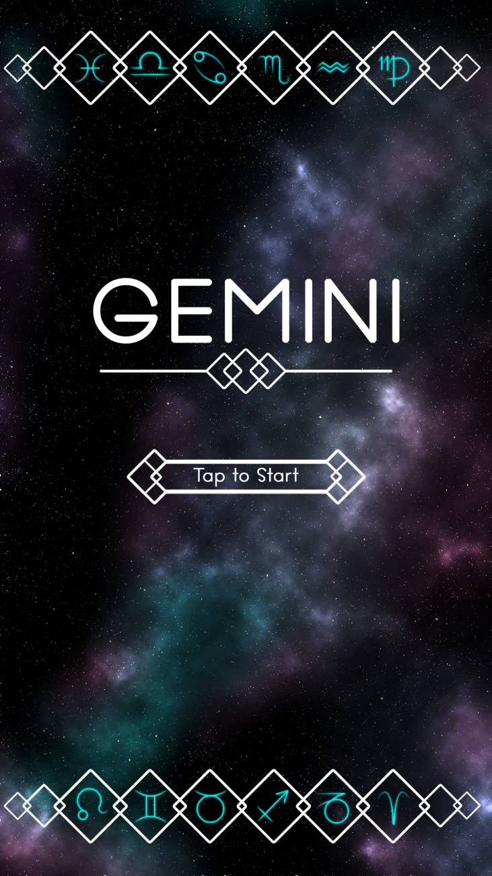
Our Brief
Mobile Platform
Potential for monetisation
Inclusion of smart depth
CW

Slide 3
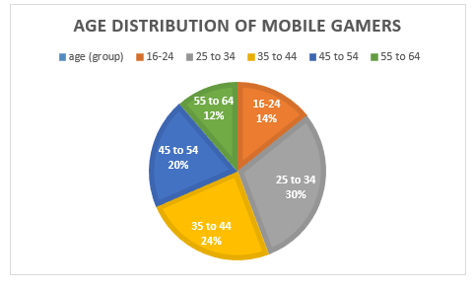
Demographic
Age: 25-44
Gender: Female
Source: http://www.realitymine.com/myth-busting-mobile-gaming-demographics/
JM

Slide 4
Psychographic
Emily
Favourite colour: Purple
Enjoys her own casual style
Enjoys shopping and reading in her spare time
Enjoys matching games
Times she spends each day on games: 2 hrs
Enjoys using social networks in the evening when she gets home to connect with her family and friends
JM

Slide 5
Extrinsic and intrinsic motivation
Extrinsic
Achievements
Social map- can see friends progress.
Leaderboards
Intrinsic
Overcoming challenges
Peer recognition and belonging – social aspect of play
CW

Slide 6


Platform and Genre
Platform: Mobile and Tablet
Genre: Hex based Puzzle
Duration: Up to 5 minutes
CJ

Slide 7
The Game Loop
Level start
Swap tiles
Complete level
Earn rewards
CW

Slide 8
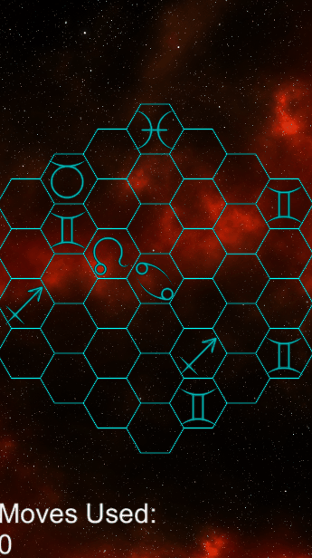
Prototype

Slide 9

Game goal and Features
Creating an unbroken chain of hexes
Using different hex types to reduce the number of moves this takes
Optimisation game
Social Map
Hard Fun:
Accomplishment
Strategy
Clear Goal
CJ

Slide 10


Hex Tile Type Concepts
Disables the tiles around it for one move
Rotates the tiles (all 6 of them) around it clockwise and anti-clockwise
JM

Slide 11
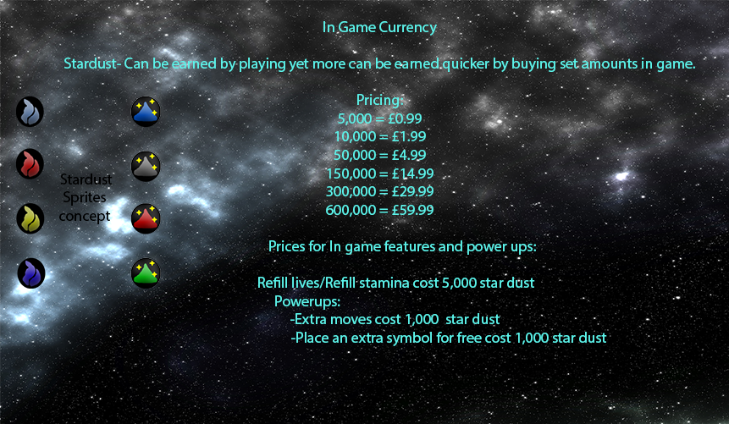
Currency
JM

Slide 12

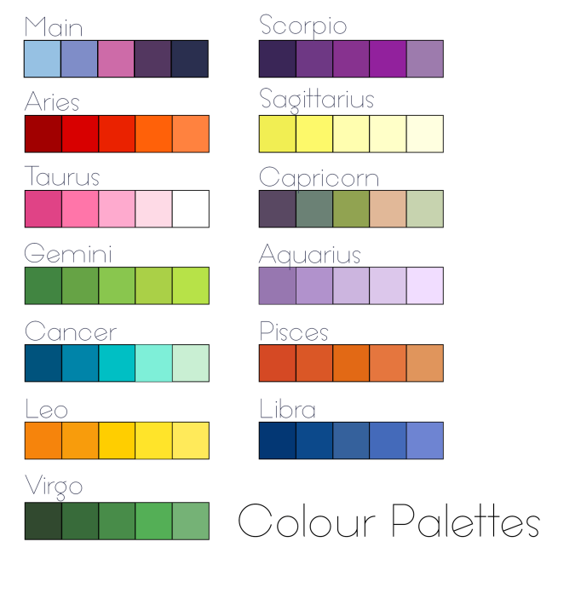

Artwork
CW/JC

Slide 13
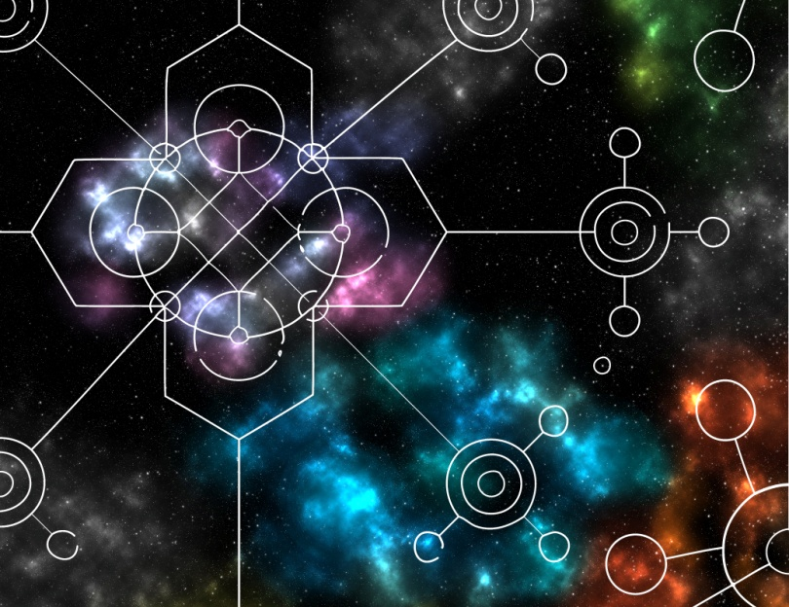
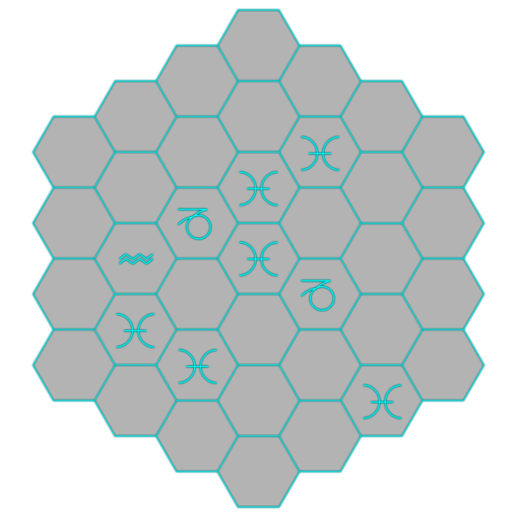
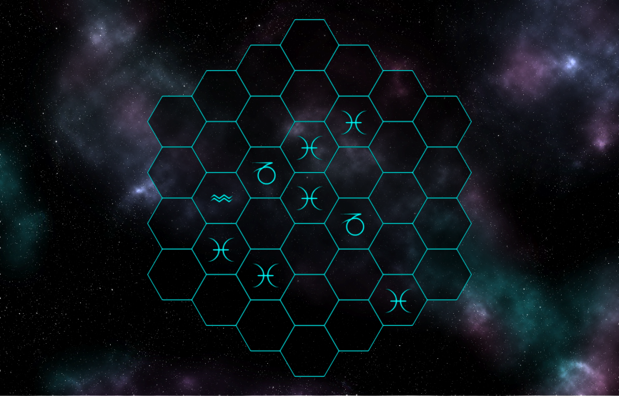
Artwork
CW

Slide 14







Artwork
CW

Slide 15
Playtesting

Slide 16
Strengths
Mechanics – easy to understand but hard to master
Suitable theme for target audience

Slide 17
Weaknesses
Unclear what to do at first glance
Multiple tile mechanics
Balancing

Slide 18
Moving forward...
Further playtesting
Finalisation of characters
Implementation of other tile mechanics
Producing levels with the level editor

Slide 19
Questions?

